Slide 1
Breath Analyser
Prateek Sharma B218031
Deepmalya Mondal B218015
Abhishek Bharadwaj B218053

Slide 2
About The Project
Breath Alcohol Tester is a device that can be used to indicate the blood alcohol content of a person.The general term of such a device is termed as Breathalyser or Breath Analyser.
Law Enforcement Organisations often use breath alcohol testers to find consumption level of alcohol by drivers.
In this project we have designed a simple breath alcohol tester .It can be used to detect the level of intoxication using the number of leds from very less consumption to intoxicated.

Slide 3
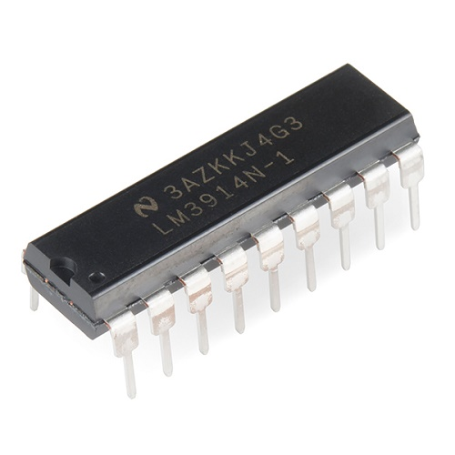
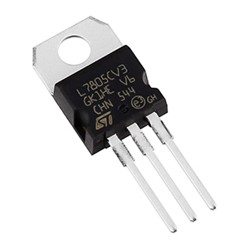
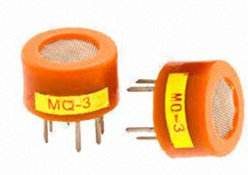
Tools used in the Project
MQ 3 alcohol detector
IC LM3914
Jumper Wires
LED (Red ,Yellow ,Green)
Resistors (470 Ω , 3.9 Ω ,2.2 Ω )
Potentiometer (20k Ω )
Bread Board
LM 7805 IC (5V Voltage Regulator)
9V Voltage Source

Slide 4
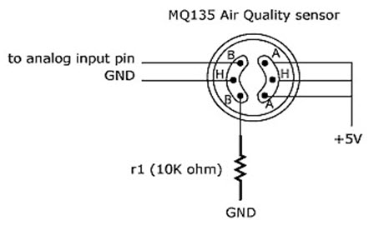
Working Principle of Sensor
The MQ series of gas sensors utilizes a small heater inside with an electro chemical sensor these sensors are sensitive to a range of gasses are used at room temperature. MQ 3 alcohol sensor is a Sno2 with a lower conductivity of clean air. When the target explosive gas exists, then the sensor’s conductivity increases more increasing more along with the gas concentration rising levels. By using simple electronic circuits, it converts the charge of conductivity to correspond output signal of gas concentration.

Slide 5
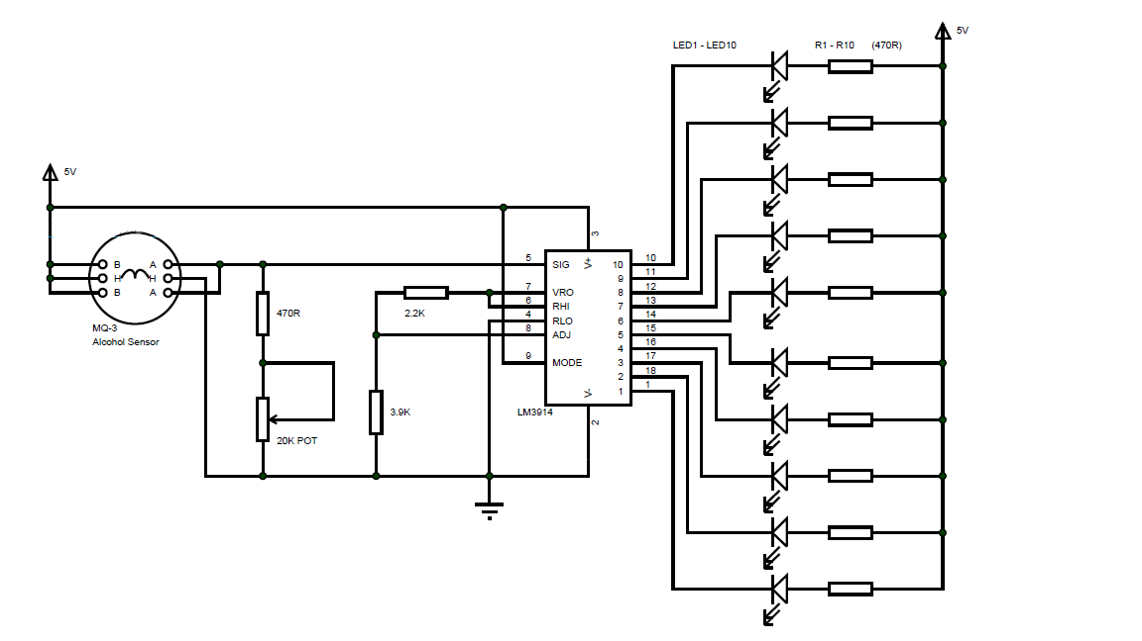
Circuit Diagram

Slide 6
Circuit Design
MQ-3 has 6 pins and the data pins can be interchanged. The heater terminals of the sensor are connected to supply and ground respectively.
MQ-3 has 6 pins and the data pins can be interchanged. The heater terminals of the sensor are connected to supply and ground respectively.
Pins 2 and 3 of LM3914 are supply pins. They are connected to Vcc and Gnd respectively. Pin 9 is mode selection pin. For normal usage, it is connected to pin 3.
Pins 4 and 6 are divider low and high pins. Pin 4 is connected to ground and pin 6 is connected to pin 7. Pins 7 and 8 are reference voltage pins. Pin 7 is connected to one end of voltage divider network formed by 2.2 KΩ and 3.9 KΩ. The other end is connected to ground. The center of voltage divider is connected to pin 8.
Pins 1, 18, 17, 16, 15, 14, 13, 12, 11 and 10 are the output pins in sequence i.e. pin 1 is output 1 while pin 10 is output 10. They are connected to 10 different LEDs of different colors.

Slide 7
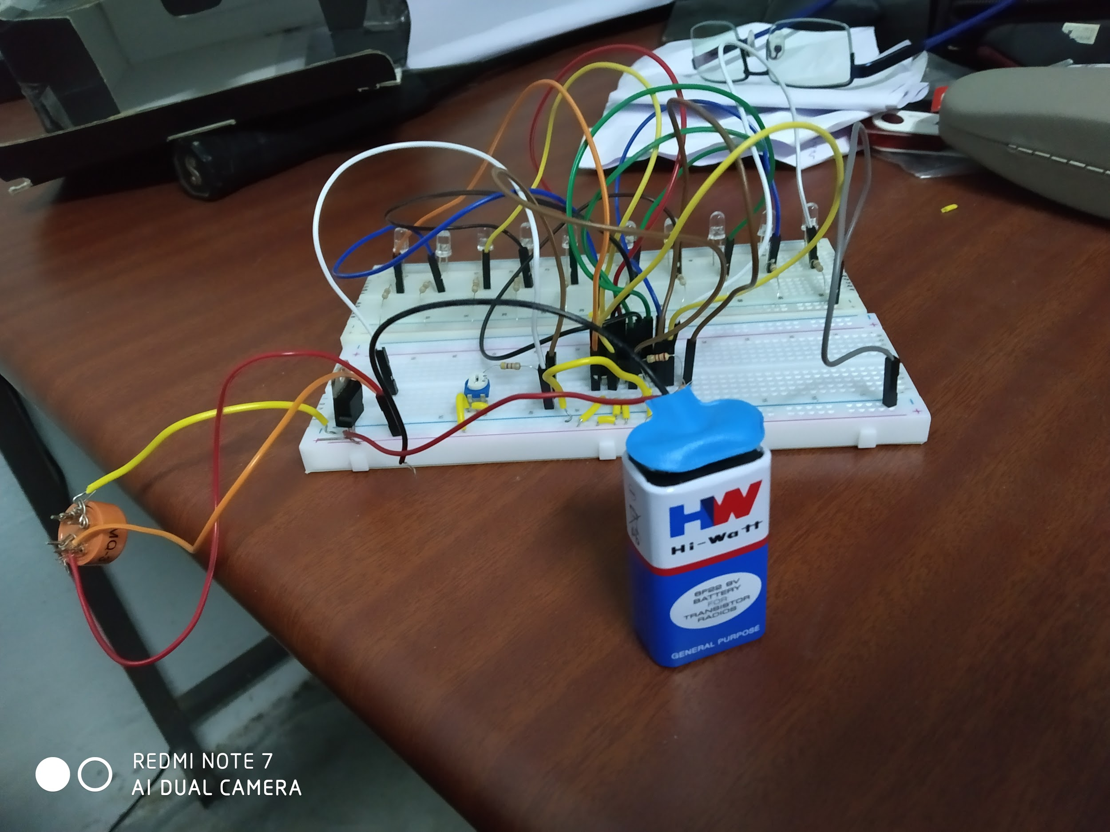
Working of the Analyser
The output is given to the signal pin (pin 5) of LM3914, which is an analog voltage sensing IC. According to the value at pin 5, the outputs are activated. For voltages between 0 and 5V, the outputs are activated from 1 to 10.
When the concentration of alcohol sensed is very less, the analog value will be slightly greater than 0V and hence only first few LEDs will glow.
When the concentration increases, the number of LEDs turning on also increases. When the concentration of alcohol is at intoxicated level, all the LEDs will be turned on. The sensitivity of the module can be adjusted by the potentiometer.

Slide 8
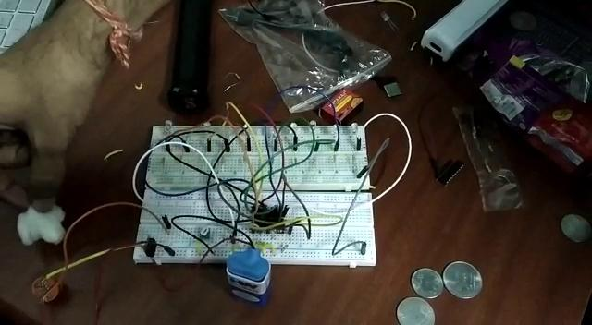
Real time working video

Slide 9
A Few Snapshots

Slide 10
Importance of Project
Area of Application
1. It is used by the traffic police to track down the person who is driving under the influence of alcohol or not(More than permissible value).
2. It is used in the organization such as sports, office, etc where drinking is considered as illegal and it is used to check whether the player is under the influence of alcohol or not.
Limitations
1. Changes in breathing patterns can affect breath results. For example, if an accused hyperventilates or exhales heavily before submitting to breath testing, their BAC(blood alcohol concentration) levels may drop considerably. On the other hand, if they hold their breath their BAC level will increase.
2. The designed breathalyzer can only measure the level of alcohol in terms of the number of LEDs glowing.It cannot measure in terms of a particular concentration level of alcohol.

Slide 11
Future Implementation in other projects
This project can be used in automobile industry which test the presence of alcohol in driver and if above permissible level it locks the engine from starting.
It can also be used with Arduino to develop a more efficient working model as well as equip it with a warning system.

Slide 12
Conclusion
In this project we developed a real time model which can detect the presence of alcohol in the subject body and we can get a rough idea about the concentration of alcohol with the number of LED indicators.Nowadays car accidents are mostly seen. This model with some improvements will help us to prevent the person from driving and thus preventing the chance of accident.

